Slide 1
What is Brute-Forcing?
Hacking with Python #1

Slide 2
Brute-force Attack
Brute-force also known exhaustive key search
Process of checking all possible keys
Using a dictionary to attack with
Dictionary is usually more effective than searching the whole key space.
Exponentially grow with increasing key size.

Slide 3
Brute-force limits
Because time/energy required to crack a key grows exponentially with key size, encryption in today’s standards and computing power are safe from brute-force attack.
A 256 bit key would take on 50 of today’s super computers 3 x 10⁵¹ years

Slide 4
Dictionary Brute-force
Much faster than a whole key space search
Not guaranteed
Commonly used on passwords
Dictionaries can be found online
A popular one is darkc0de.lst
A copy will be in the description

Slide 5
Smaller Dictionaries
Good to run before a big dictionary like darkc0de.
Can eliminate the most common passwords and default passwords for certain devices.
Eg, admin, password, welcome, 12345

Slide 6
Offline Attacks
Offline attacks are hard to be prevented because the cracker has all the time in the world to attempt to crack the password.
Cant be detected
Requires the hashed password as well as the hashing system. (can be difficult to obtain)
Process of hashing each word in the dictionary and comparing it to the hashed password.

Slide 7
Online Attacks
Can be prevented most of the time with attempt restrictions and cool down times between each attempt.
Easier to detect (1000’s of login attempts seconds apart would be suspect for and admin, would also slow the site with so many requests)
Still will work as people are forgetful and don’t think of security.

Slide 8
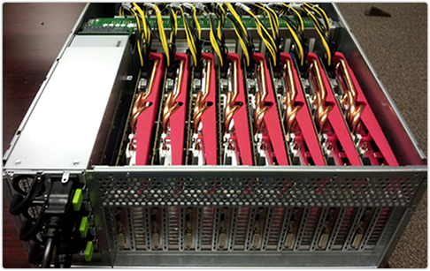
Cracking Machines
If it was crucial that keys were cracked ASAP you could build a machine dedicated to cracking.
Uses a GPU array and uses the GPU’s processing power to process multiple keys at once, speeding up the process.

Slide 9
Next
Unix Password Cracker
Feel Free to leave questions in the comments I’ll try to answer all of them.

